Slide 1
Highlights of HTML/Phaser
More powerful than python.
Tons of games as examples.
Cleaner Code.
Better interactions.
It’s the future, Get with it!

Slide 2
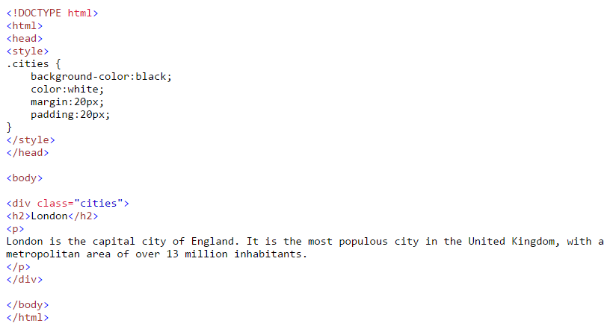
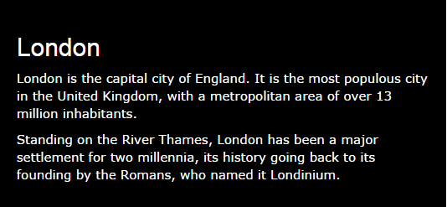

Slide 3
Questions
None

